Slide 1
info 5717 Dynamic WWW Structures Group- 7 FINAL PROJECT REPORT T4 – FORUMS AND ONLINE COMMUNITIES ON VISUALIZATION, SOCIAL NETWORK ANALYSIS, DATA & TEXT MINING, INFORMATION RETRIEVAL& MACHINE LEARNING
Instructor: Dr. Jiangping Chen
Report By
Pooja Dubbaka
Amruta Mungikar
Divya Yerramsetty

Slide 2
OBJECTIVES
This project builds the database of the forum and online communities which discusses and provides information on Machine learning (Supervised and Unsupervised learning), Datamining, Text Mining, Information Retrieval, Visualization, and Social Network Analysis.
A Forum is a place where ideas or views are exchanged and discussed.
Multiple users who wish to enter information about online sites can login to this website and enter a lot of information to keep track of the sites they found on internet and also facilitate other new users to refer to the records to find any related information.

Slide 3
USERS’ REQUIREMENTS
This website provides the following requirements to the users:
To sign up and login to access the website.
To enter records about the title topic using the “Record Entry Form”. So if a user finds some interesting forum and posts resolved in them, he can keep record of all of them.
It facilitates users to view the different categories of online sites categorically form the “Category Search Page”.
Users can find the solutions/answers to posts which are related to their area of interest form the “Post Search Page”.
All posts and information in the website is accessible to only Signed up users.

Slide 4
ENTITIES USED IN THE DATABASE
USER: This entity contains details about the user who posted in the Forum. It consists of name, email address of the user along with date of registering into the website. It is identified by unique key which is given to a single user uniquely.
FORUM: This is the major entity in the database, it provides the name, URL of the forums, this entity is identified by its id (identification number), it connects to category table, post table and user table.
CATEGORY: This entity provides the details of the category name and category description. It is identified by a unique key that is given to each category uniquely.
POST: This entity consists of details namely content of the post, when was the post created, in which forum does the post exist, who posted the post.
CREATOR: This entity consists of details about creators’ name, date of creation. A creator id uniquely identifies this entity. Creator is the publisher of the Forum/ online community.

Slide 5
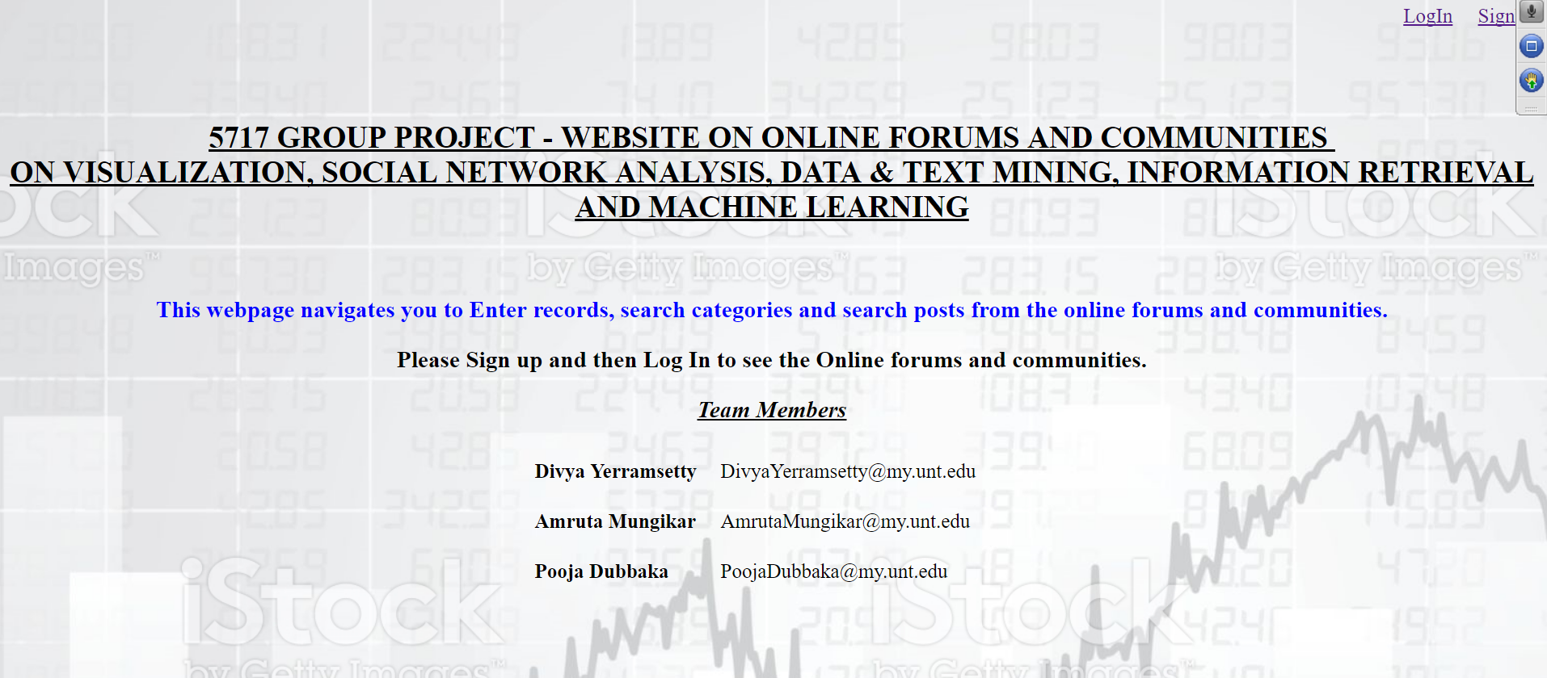
FUNCTIONING OF WEBSITE
In order to access website, first sign up and then login here.

Slide 6
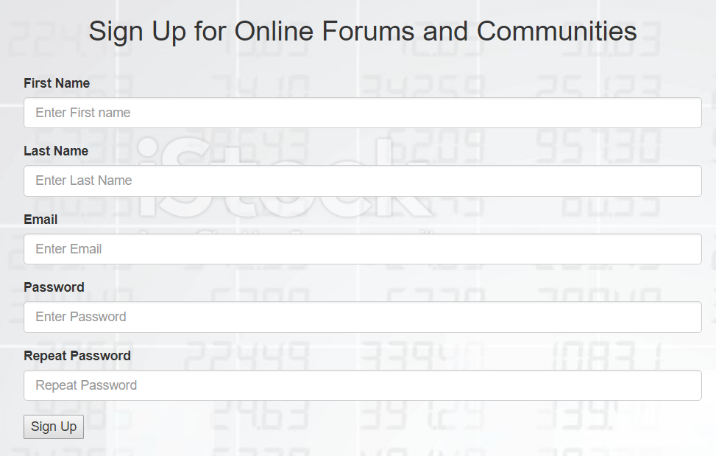
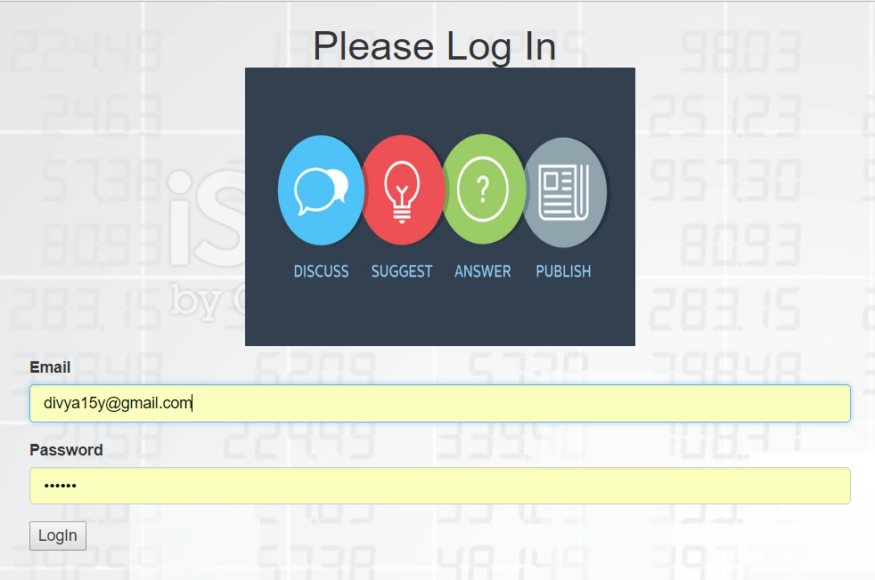
USER CREDENTIALS FORMS
SIGN UP PAGE
LOGIN PAGE

Slide 7
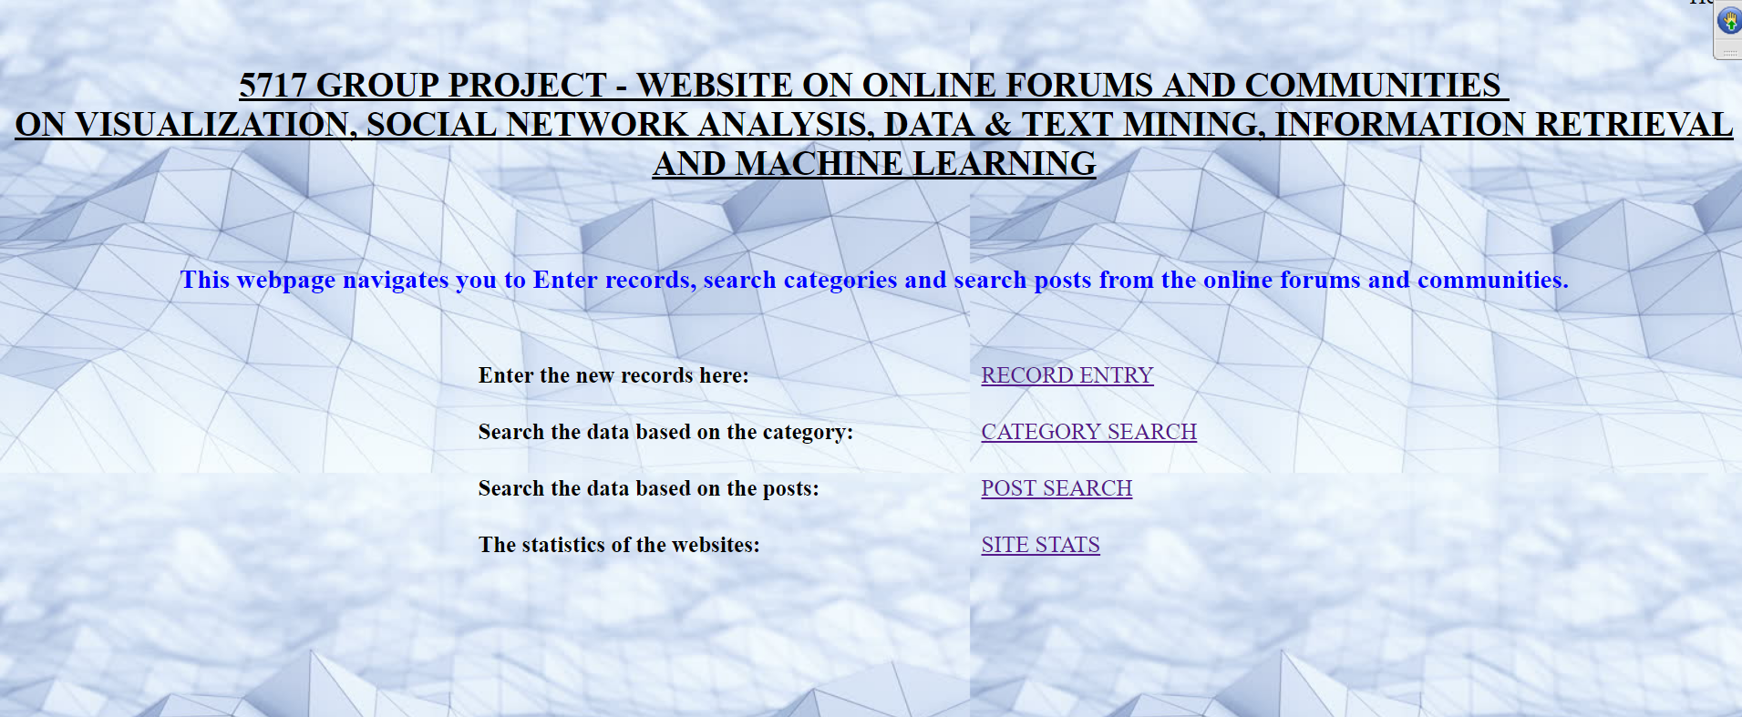
HOME PAGE

Slide 8
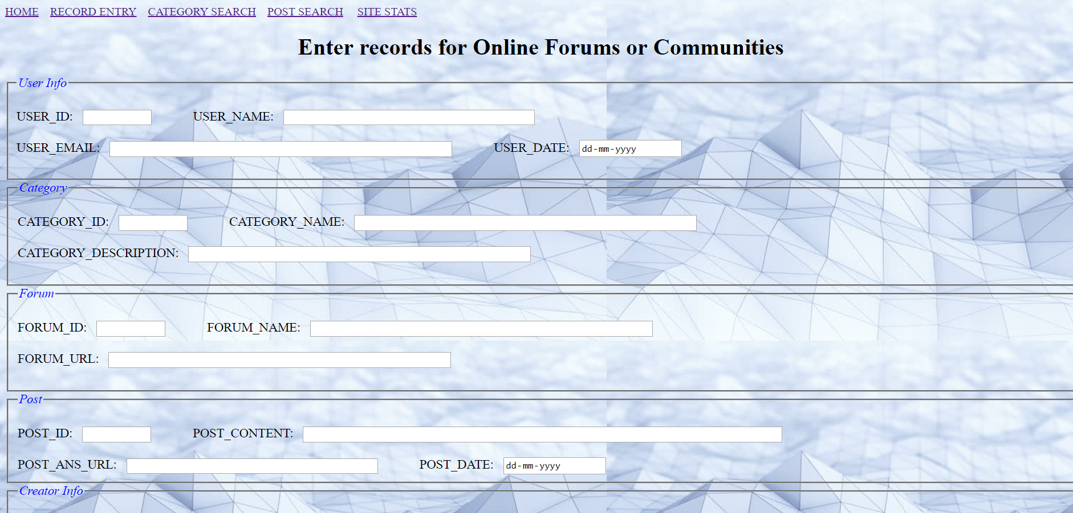
WEBSITE NAVIGATION
Record Entry page in the website

Slide 9
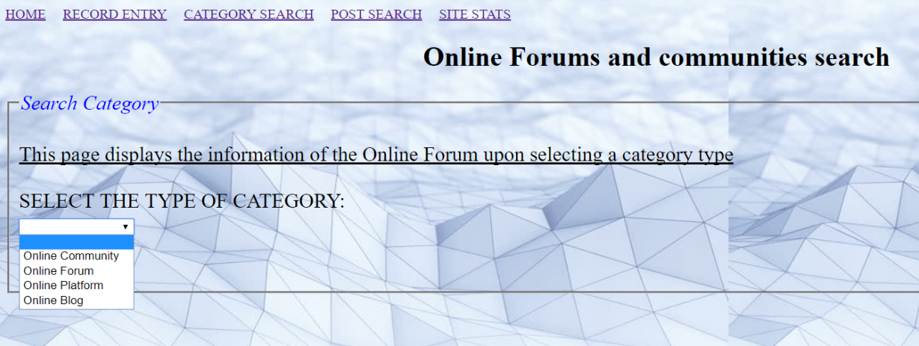
SEARCH RETRIEVAL AND RESULTS
Category Search
Select a
category

Slide 10
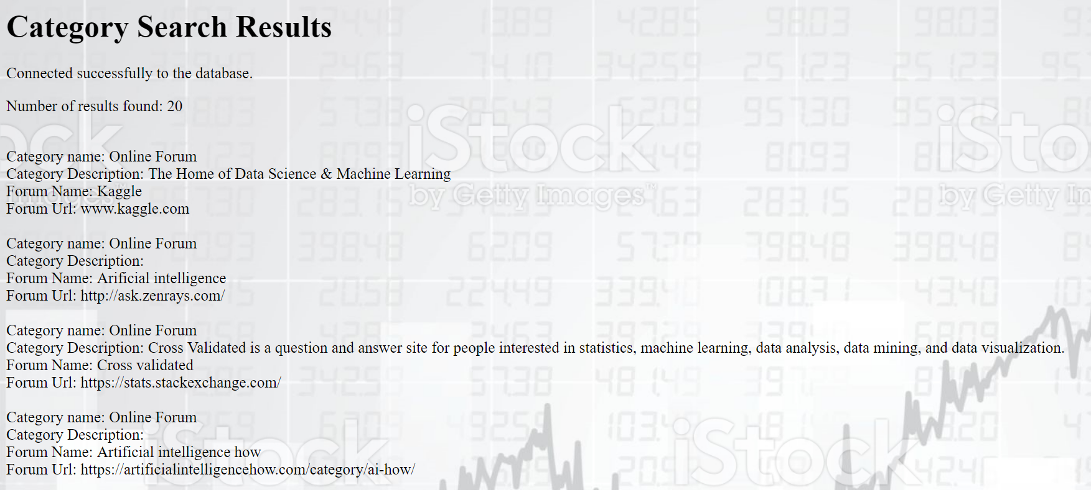
SEARCH RETRIEVAL AND RESULTS
RESULTS FOR CATEGORY SEARCH ON SELECTING “Online Forum”.

Slide 11
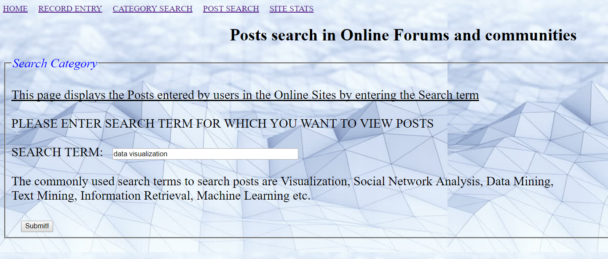
SEARCH RETRIEVAL AND RESULTS
2. Post Search
Search term needs to
be entered in the text
box provided.

Slide 12
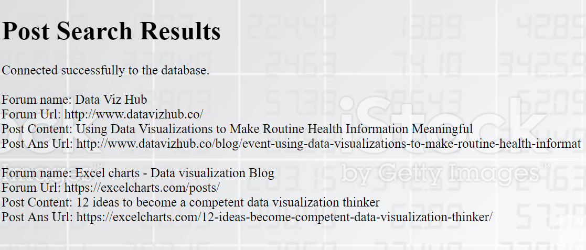
SEARCH RETRIEVAL AND RESULTS
RESULTS FOR POST SERACH UPON ENTERING THE SEARCH TERM “data visualization”.

Slide 13
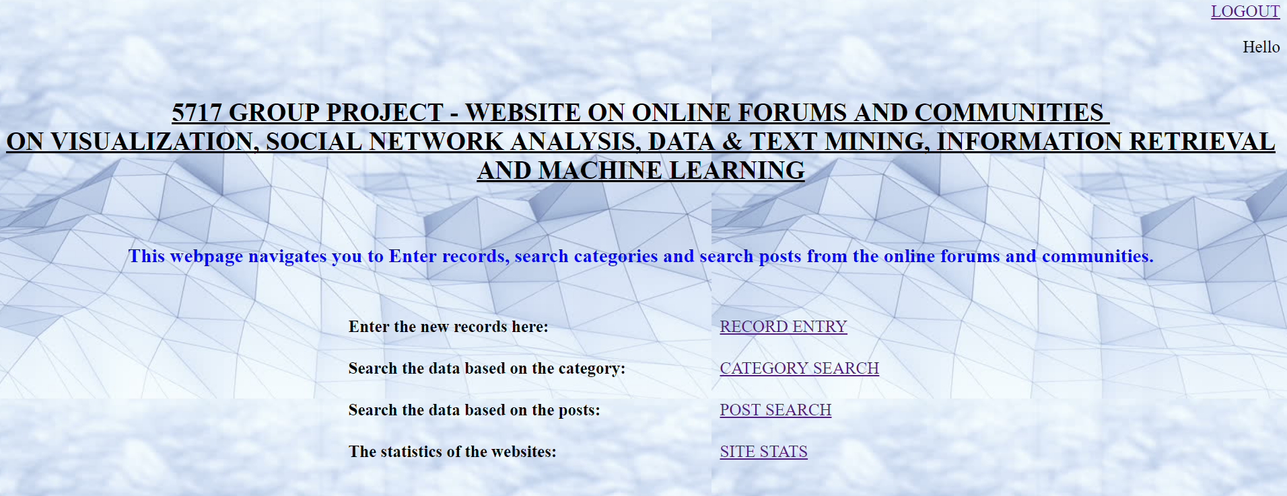
LOGGING OUT FROM THE WEBSITE
To “Log out” from the website, navigate back to home page.

Slide 14
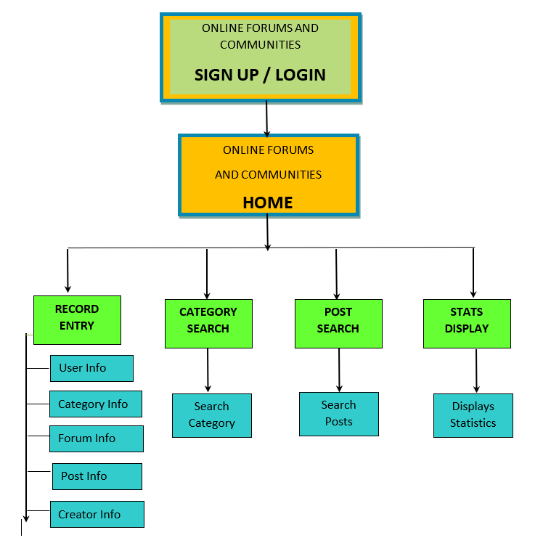
SITE MAP

Slide 15
URLS OF THE WEBSITE
Please login to the website with the following credentials:
Email: 5717G7@my.unt.edu
Password: group7
Main Home page for Signup or Login: http://iia02.ci.unt.edu/5717/group7/homepage.php
Home page after logging into website: http://iia02.ci.unt.edu/5717/group7/Group7_Teamproject.php
Record entry page: http://iia02.ci.unt.edu/5717/group7/rec_entry.html
Category search page: http://iia02.ci.unt.edu/5717/group7/rec_search.html
Post search page: http://iia02.ci.unt.edu/5717/group7/post_search.html
Stats display page: http://iia02.ci.unt.edu/5717/group7/stats.html

Slide 16
THANK YOU!!

